Slide 1

KX-023 Accelerometer Sensor
Kevin Witaszek
TechBOYS

Slide 2
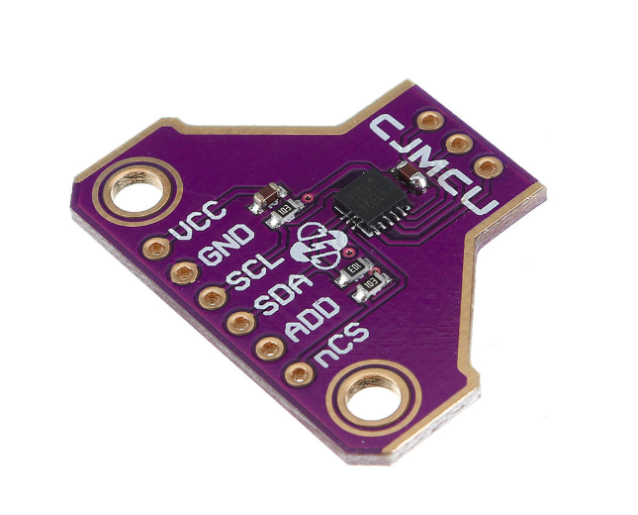
Proposal
Low Power Consumption
Digital I2C up to 3.4 MHz
High Shock Survivability
Excellent Temperature Performance
Tracks x,y,z movements thats used to record the steps
Will be used as a pedometer in the Smart Watch project which will made in the next semester with Antonio

Slide 3
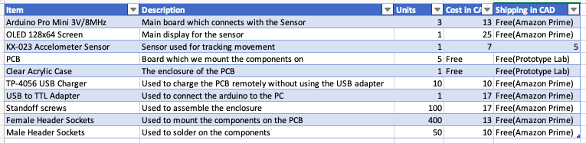
Budget
Total: 112 $ CAD

Slide 4
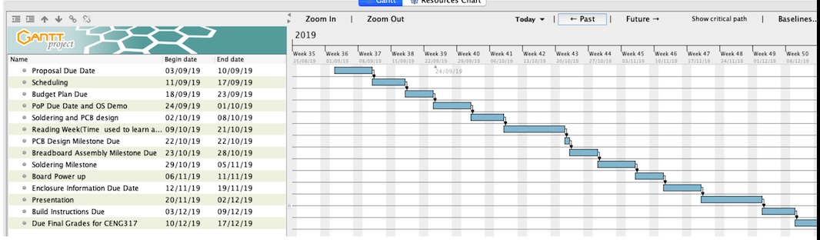
Schedule

Slide 5
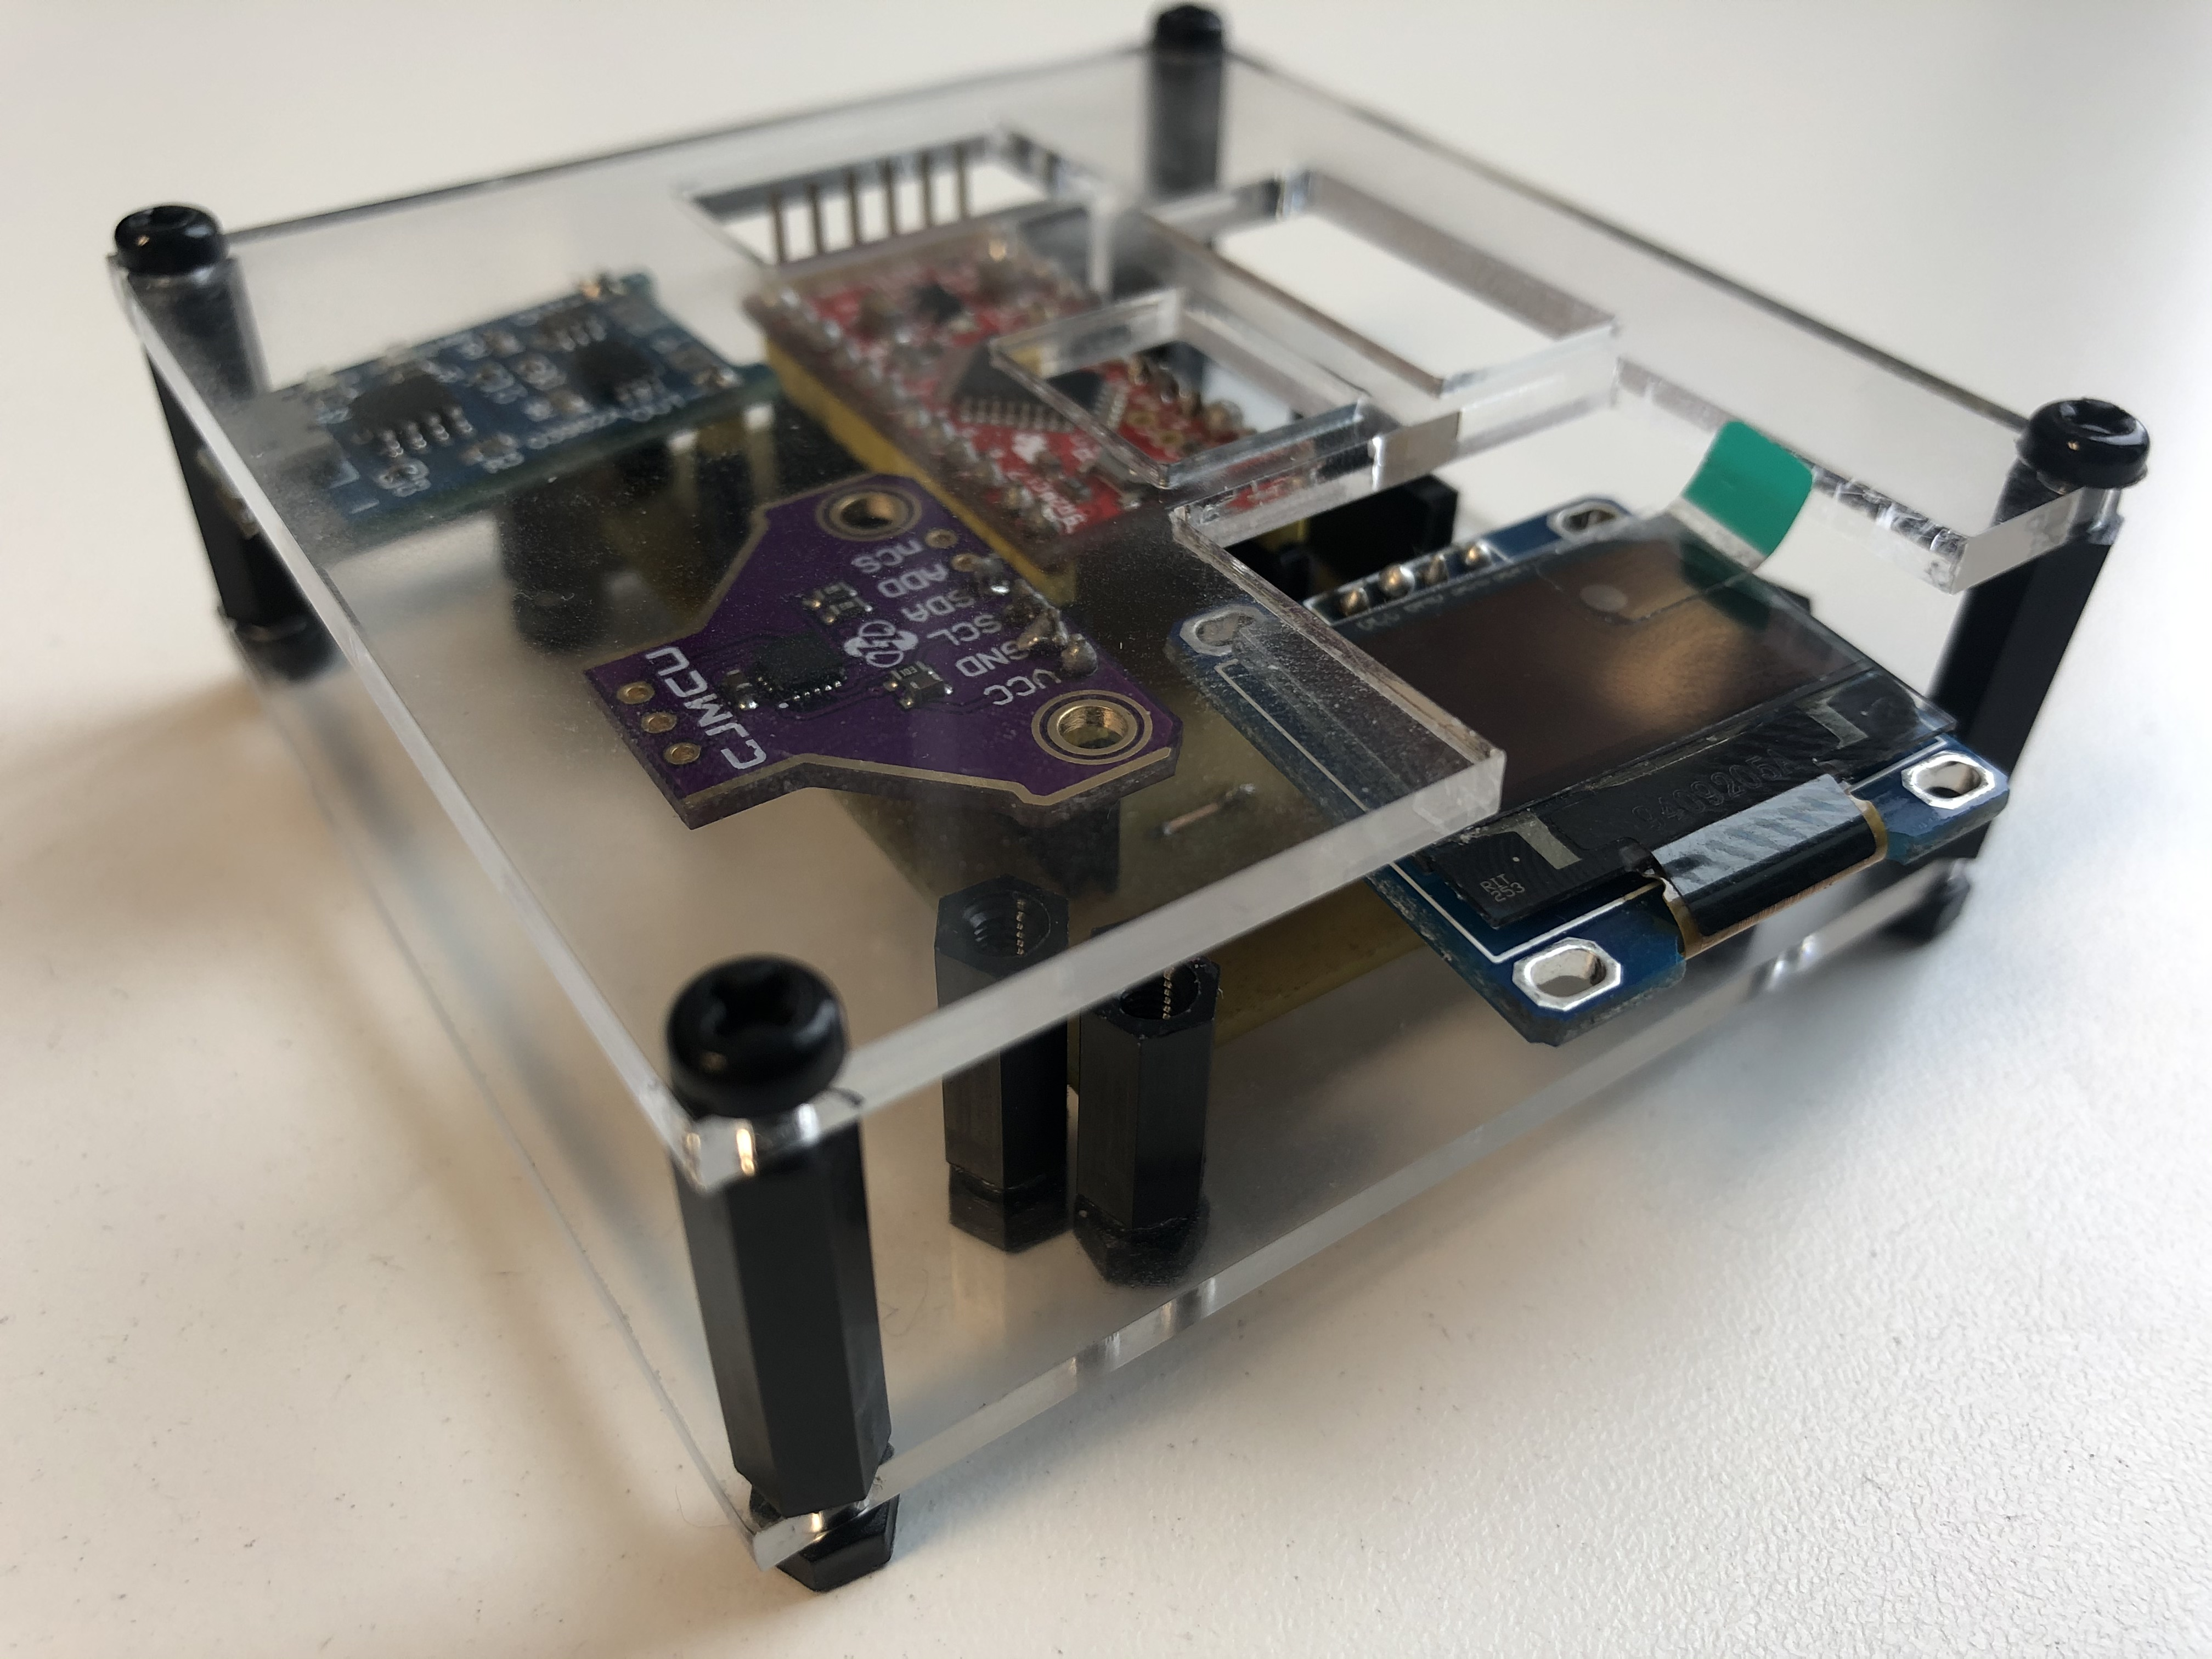
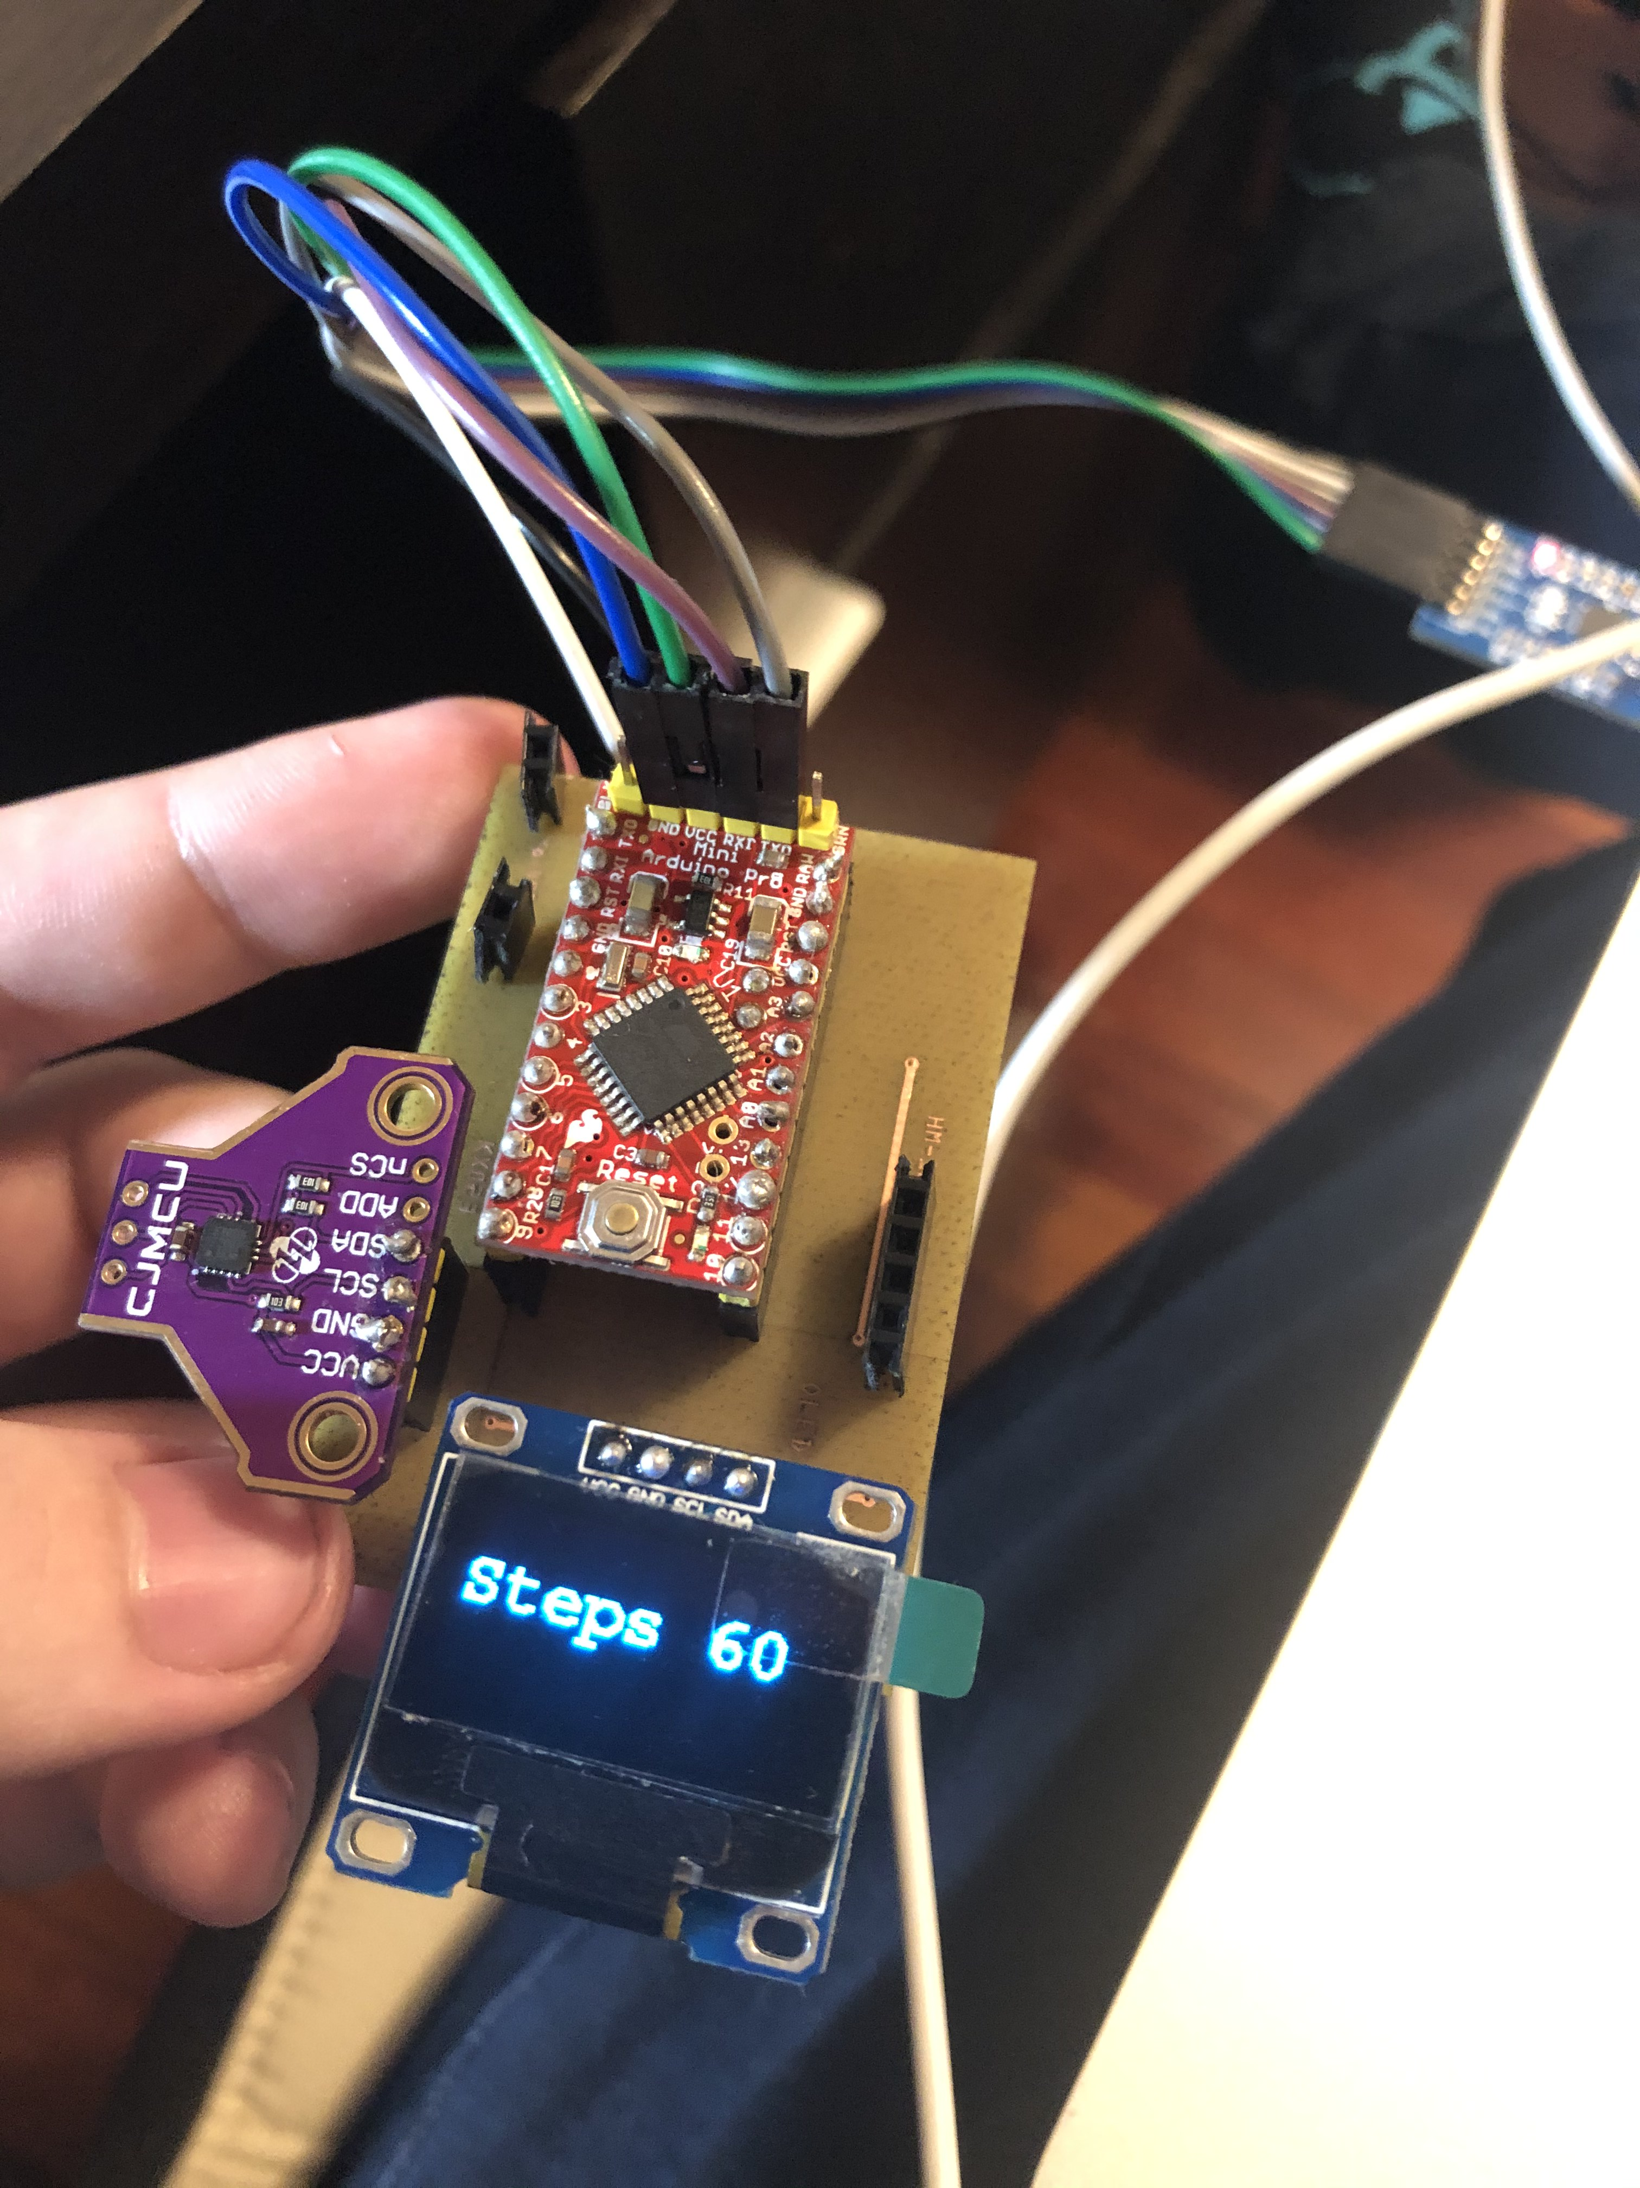
Project Images

Slide 6
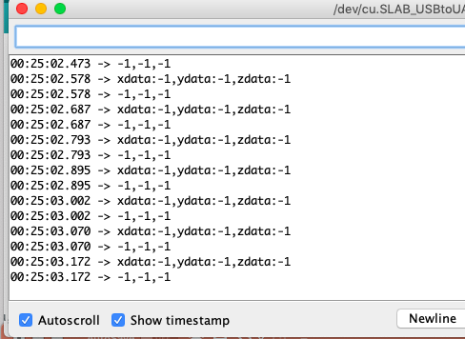
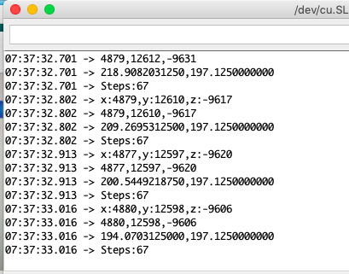
Sensor Reading(Demo)

Slide 7
Previous course knowledge used
TECH 101 Electric Circuits – Learnt basics of circuitry and how to make measurements
TECH153 Technical C – Learnt advanced topics of C
CENG209 Micro Assembly Language Assembly – Knowledge of AtMega328P was used for my project
CENG215 Digital and Interfacing Systems – Work with various sensors.
CENG216 Introductions to Software Engineering – Learn the basics of software development and making Gantt charts
CENG252 Embedded Systems – Learnt how to work with a project
CENG317 Hardware Technology Production- Learnt how to solder

Slide 8
Thanks for listening !!!

